Slide 1
Fraudulent Claim Detection
SUBMITTED BY:
Prakher Singhal
Pranay Jain

Slide 2
Contents
Problem statement
Business Objective
Approach
Summary
Questions asked in Case Study
Recommendations
Business Implications
Conclusion

Slide 3
Problem Statement
Global Insure, a leading insurance provider, processes thousands of claims every year. However, a significant percentage of these claims are fraudulent, leading to substantial financial losses.
Current Challenges
Manual inspections are used to detect fraud.
The process is time-consuming and inefficient.
Fraud is often detected after payouts are made, resulting in avoidable losses.
Business Objective
Leverage data-driven techniques to:
Classify claims as fraudulent or legitimate early in the process.
Minimize financial losses.
Optimize the claims handling workflow for faster, more accurate decisions.

Slide 4
Business Objective
Global Insure aims to develop a predictive model that classifies insurance claims as either fraudulent or legitimate, leveraging historical claim data and customer profiles. By analyzing features such as claim amount, customer demographics, and incident details, the company seeks to:
Identify fraudulent claims early in the process,
Minimize financial losses, and
Improve decision-making efficiency within the claims approval workflow.

Slide 5
Approach
📥 Data Loading
Import and inspect the dataset.
🧹 Data Cleaning
Handle missing values and inconsistent entries.
Special focus on NULL and '?' values.
Replace '?' in categorical columns with 'UNK'.
Visualize distributions and assess data quality.
📊 Exploratory Data Analysis (EDA)
Univariate Analysis to understand individual feature distributions.
Correlation Analysis to identify relationships among features.
Target Likelihood Analysis to evaluate feature impact on fraud.

Slide 6
Approach
🏗 Data Preparation
Split data into training and testing sets.
Engineer features to capture meaningful patterns.
Address class imbalance with resampling techniques.
Use VIF (Variance Inflation Factor) to check for multicollinearity.
Create dummy variables for categorical features.
Apply feature scaling where necessary.
✅ Feature Selection
Use RFECV (Recursive Feature Elimination with Cross-Validation) to select top predictors.
🤖 Model Building
Logistic Regression: Tune cutoff using ROC curve.
Random Forest Classifier as an additional model.
📈 Model Evaluation
Evaluate models using Accuracy, Sensitivity , Specificity Precision, and Recall and F1- Score.
Generate actionable insights to improve fraud detection strategies.

Slide 7
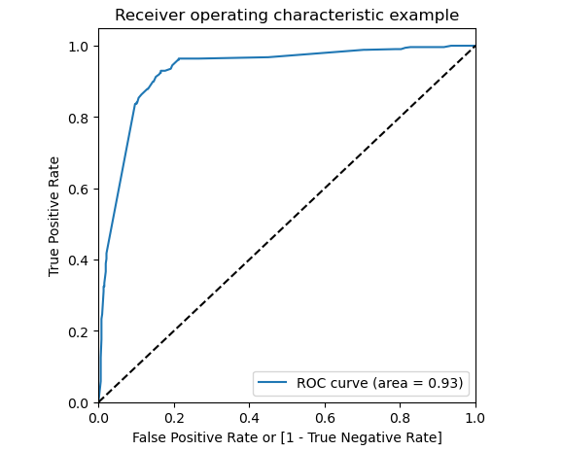
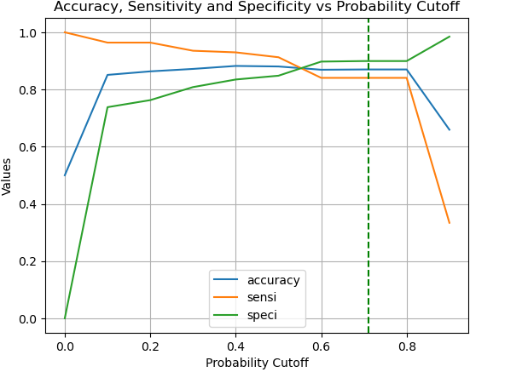
Summary- Logistic Regression
The Receiver Operating Characteristic (ROC) Curve above illustrates the diagnostic ability of the logistic regression model used for fraud detection.
The optimal cutoff chart shows how changes in the probability threshold impact key performance metrics—accuracy (blue), sensitivity (orange), and specificity (green)—for the logistic regression model used in fraud detection. This visual helps in selecting a threshold that strikes the right balance between correctly identifying fraud and minimizing false positives. We selected 0.4 as the cut-off value for the model, as thresholds between 0.2 and 0.8 produce similar prediction probabilities, making 0.4 a balanced and reliable choice

Slide 8
Summary- Logistic Regression
Metric | Train dataset | Test dataset
Accuracy | 88% | 83%
Sensitivity | 91% | 71%
Specificity | 84% | 87%
Precision | 85% | 65%
Recall | 91% | 71%
F1-Score | 88% | 68%

Slide 9
Summary- Random Forest
Metric | Train dataset | Test dataset
Accuracy | 88% | 83%
Sensitivity | 90% | 77%
Specificity | 85% | 84%
Precision | 85% | 62%
Recall | 90% | 77%
F1-Score | 88% | 69%

Slide 10
Summary
In fraud detection, recall is especially important because it measures how well the model identifies actual fraud cases
Logistic regression and Random Forest.
Model | Accuracy (Train) | Recall (Train) | Accuracy (Validation) | Recall (Validation)
Logistic Regression | 88% | 91% | 84% | 72%
Random Forests | 87% | 84% | 83% | 77%

Slide 11
Questions asked in Case Study
How can historical claim data be analyzed to identify fraudulent patterns? Response: To identify patterns associated with fraudulent claims, we begin with Exploratory Data Analysis (EDA) using techniques such as data visualization, correlation analysis, and examination of class imbalances. This is followed by feature engineering and resampling techniques to prepare the data for model training.
Which features appear to be most indicative of fraudulent behavior? Response: Analysis suggests that features like Hobby chess, Incident Severity Minor Damage, , Incident Severity Total Loss, and Hobby cross-fit are significant predictors of potential fraud.

Slide 12
Questions asked in Case Study
Is it possible to estimate the likelihood of fraud for new claims using historical data? Response: Yes, the Random Forest model and Logistic regression model achieves good classification report , making it suitable for estimating the probability of fraud in new insurance claims based on historical data.
What insights can be drawn from the model that can help in improving the fraud detection process?
Based on the final model outputs, the following key insights were identified:
Hobby: Cross-Fit: Claims from individuals with cross-fit as a hobby show a strong link to fraud, with a high coefficient indicating increased fraud likelihood.
Hobby: Chess hobby is also show a higher likelihood of fraudulent claims, with a coefficient suggesting greater fraud risk.
Incident Severity: Minor Damage claims are less likely to be fraudulent, as indicated by a negative coefficient .
Incident Severity: Total Loss claims have a negative association with fraud, with a coefficient suggesting lower fraud risk.

Slide 13
Recommendations
Flag High-Risk Hobbies
Prioritize claims with chess or cross-fit hobbies for additional verification due to their strong fraud correlation.
Streamline Minor Damage Claims
Fast-track and automate minor damage claims to improve efficiency, as they show low fraud risk.
Optimize Total Loss Processing
With total loss claims having low fraud risk, reduce manual checks and reallocate resources to higher-risk cases.
Focus on Intermediate Severity Claims
Give extra attention to claims with moderate severity, as they may present a higher fraud risk and require enhanced detection.

Slide 14
Business Implications
The Random Forest model offers a more robust and reliable approach to detecting fraudulent claims.
Logistic Regression appears less suitable in this context, primarily due to its tendency to overfit the data.
By deploying a Random Forest-based fraud detection system, Global Insure can improve early fraud identification, streamline processes, reduce customer inconvenience, and boost overall detection efficiency.
With a solid recall rate of 77%, the model effectively captures true fraud cases, indicating strong potential for ongoing training and improved performance over time.

Slide 15
Conclusion
The Random Forest model demonstrates strong performance with an 77% recall, indicating its effectiveness in accurately identifying fraudulent claims.
Implementing this model can significantly strengthen Global Insure’s fraud detection capabilities.
By proactively detecting suspicious claims, the company can reduce unnecessary processing delays, enhance customer experience, and improve the overall efficiency of fraud prevention efforts.

